Slide 1
A 2016 Joint Statistical Meetings Topic-Contributed Panel
Visualizing the Power of Evidence-Driven Policy in Countries in Transition
Giang Nguyen, Star Ying, Hannah Cho, Ariel Lee
International Strategy and Reconciliation Foundation
Igor Barahona
Mathematics Institute of the UNAM, Mexico

Slide 2

https:/ star-is-here.github.io/jsm-deck/

Slide 3
Giang Nguyen (ISR Foundation Center for Interdisciplinary Research)
Clara Kyung (McGill University)
Ariel Lee (ISR Foundation Center for Science Diplomacy) Tiffany Lee (ISR Foundation Center for Science Diplomacy) Hannah Cho (University of Pennsylvania)
Elliott Chun (University of North Carolina, Chapel Hill) Cindy Won (Brown University)
Star Ying (Commerce Data Service, U.S. Department of Commerce) Asaph Young Chun (U.S. Census Bureau)
Note: All authors are afiliated with the International Strategy and Reconciliation Foundation.

Slide 4
Introduction
Research questions Methodology
Policy challenges in developing countries Power of evidence-based policymaking Principles of data visualizations Demonstration of data visualizations Conclusion

Slide 5
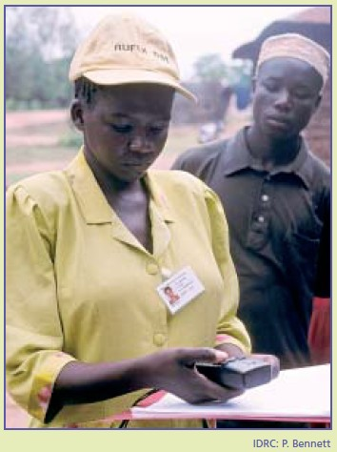
In 1996, the Tanzania Essential Health Interventions Project was launched.

Slide 6
Over 40% reductions in infant mortality between 2000 and 2003 in two pilot districts

Slide 7
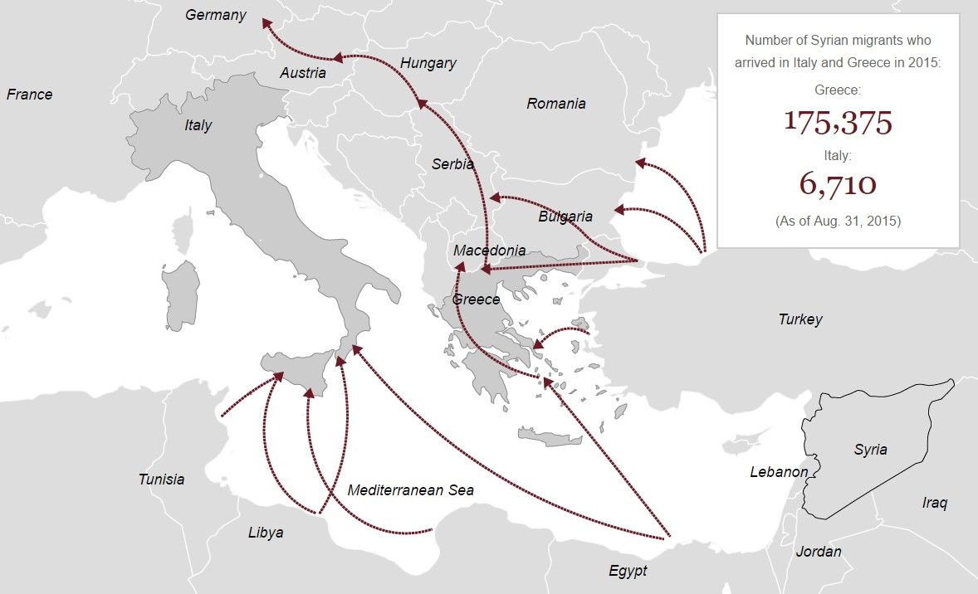
From “2015: The Year in Graphics”, Los Angeles Times

Slide 8
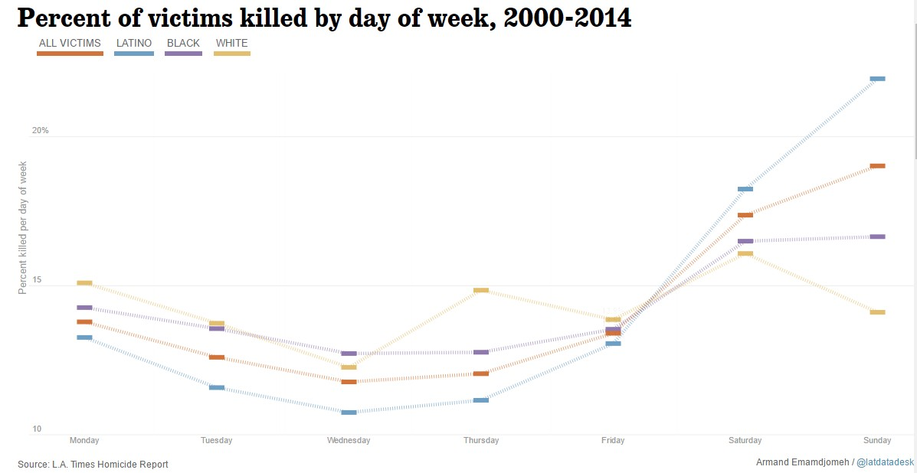

Slide 9
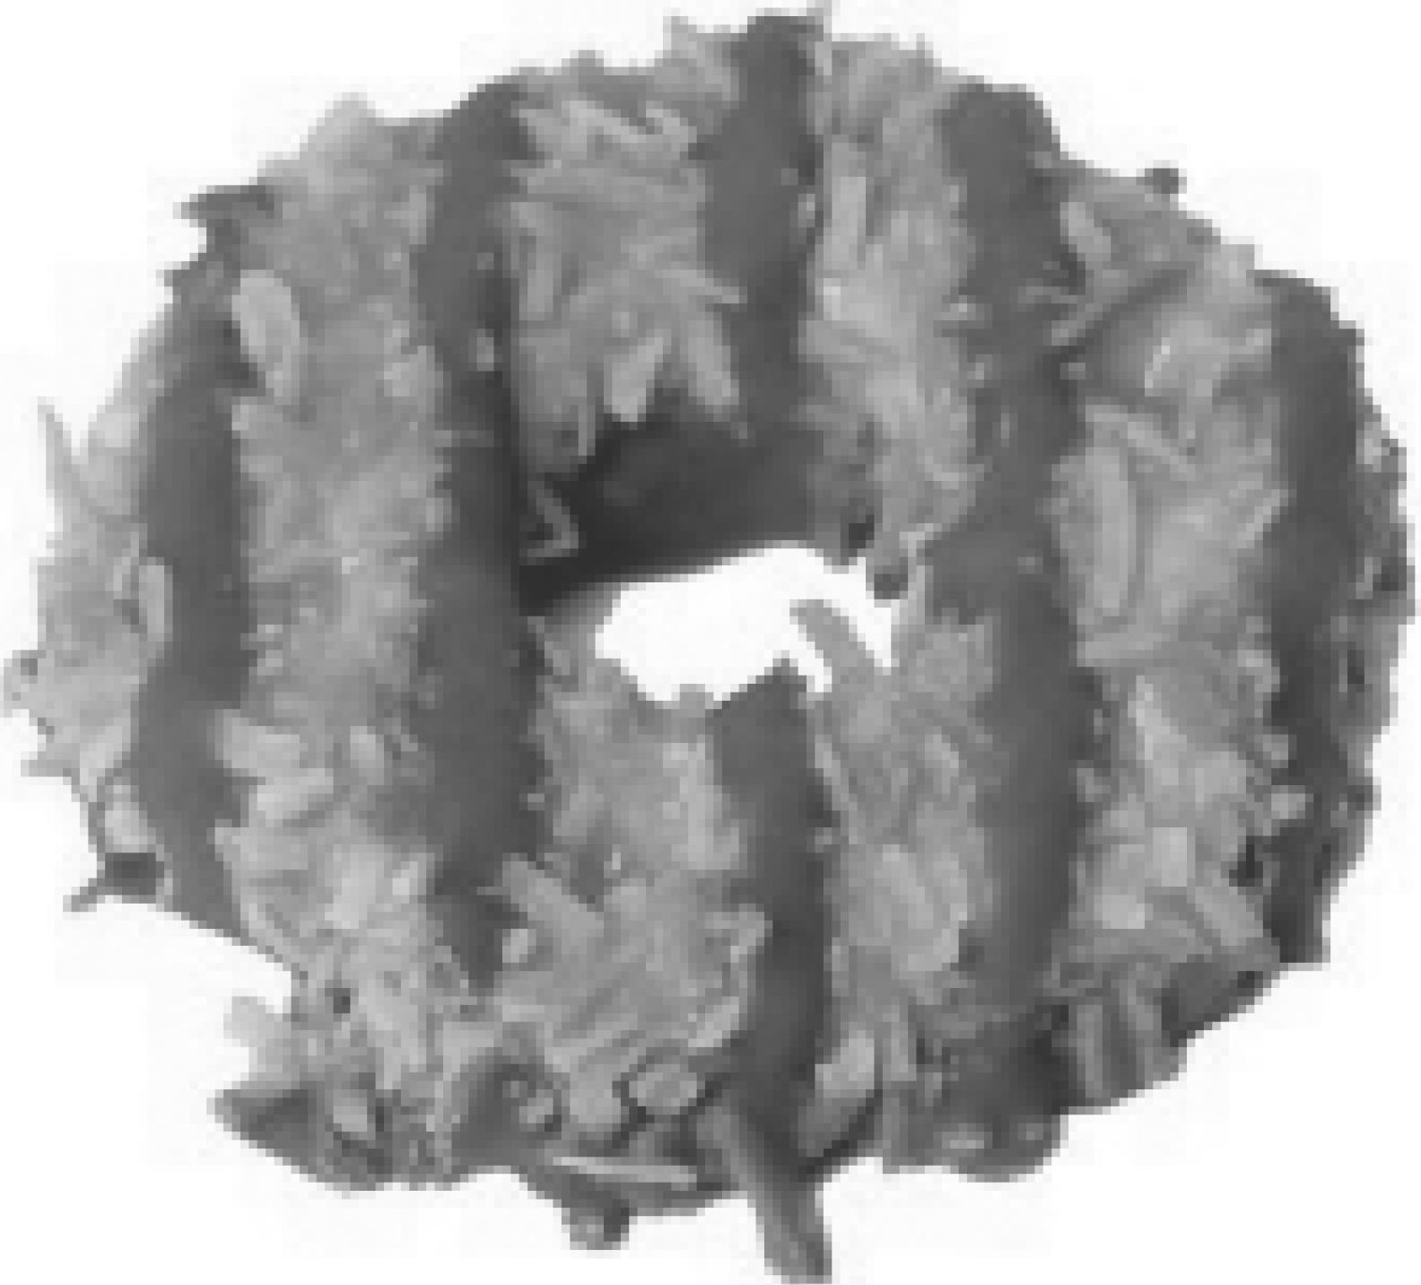
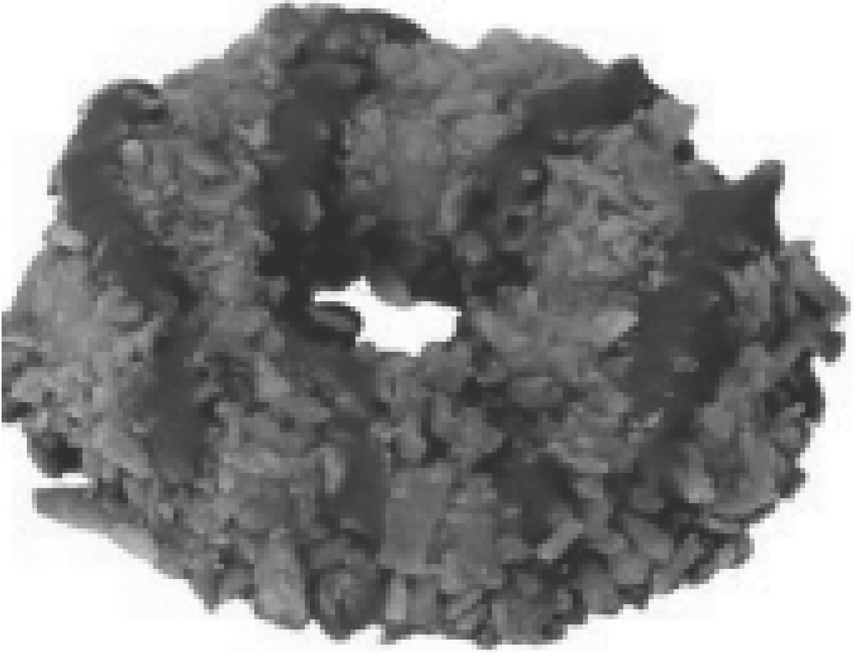



Sa111oas
l\1ore oookie than caramel, milkier
cha oolate· ,oooki.e l1as
vanilla fla,or
Heavier carame] layer darker chooolate coating n1ore toasted cocoi]ut
$0.31
COST*
$0.36
65
CAlORIES
70
3.0g
TOTAll. FAT SUGA R PROTEIN
6 .0g
II0 .5g
5.0 g
0.5g

Slide 10
From “2015: The Year in Graphics”, Los Angeles Times

Slide 11
Investigate the power of data visualization as an evidence-based approach to policymaking

Slide 12
DVs and EBP in countries in transition? Multiple data sources?
How to demonstrate power of EBP with DVs? Merits and drawbacks of EBP and DVs?

Slide 13
Three main sources of data:
United Nations’ Millennium Development Goals Indicators World Bank’s Open Data
DPRK Survey and Census Data
Develop DVs pertaining to health, economic, and social issues in countries in transition

Slide 14
Incredible progress has been made in achieving the Millennium Development Goals set in 2000.
Nonetheless, there still remains much work to be done in a variety of areas towards Sustainable Development Goals the U.N. aims to accomplish by 2030:
Poverty and hunger Gender inequality
Child and maternal mortality Disease
Environmental sustainability
Setbacks due to crises, shocks, and vulnerabilities

Slide 15
Extreme Poverty and Hunger

Slide 16
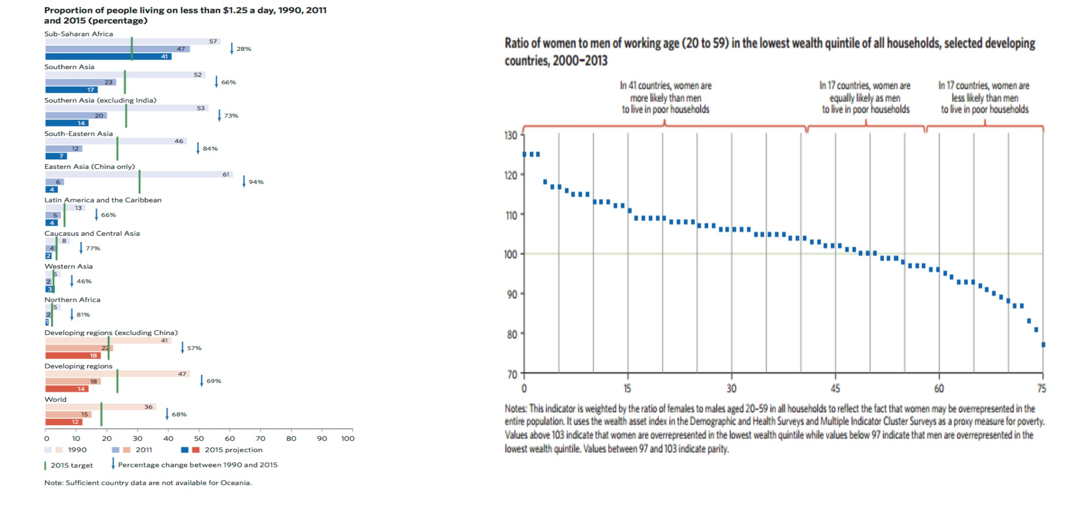

Slide 17
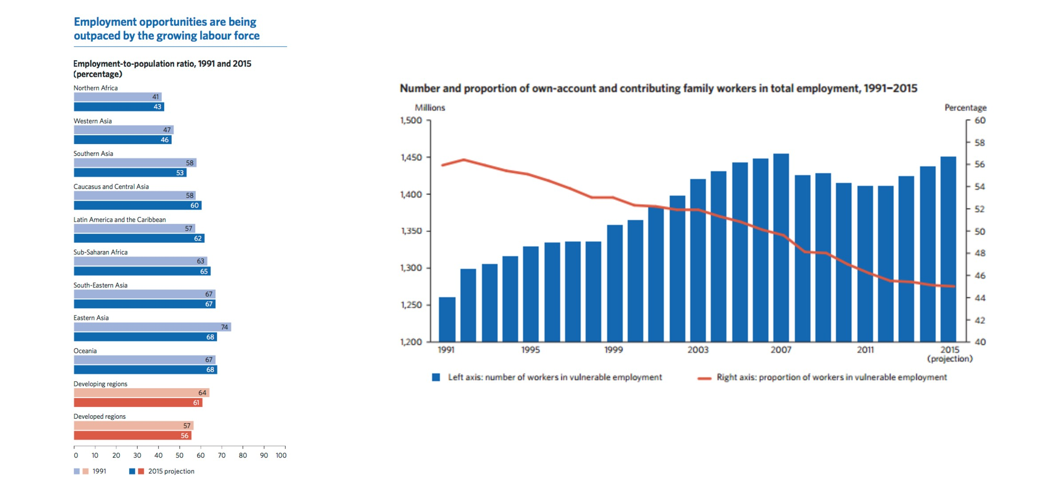

Slide 18
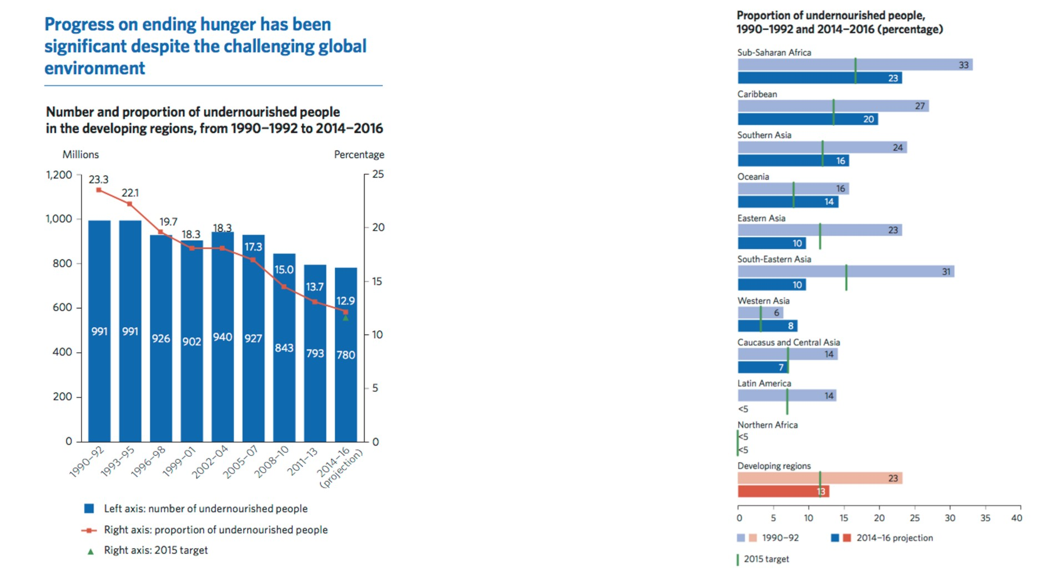

Slide 19
Gender Inequality

Slide 20
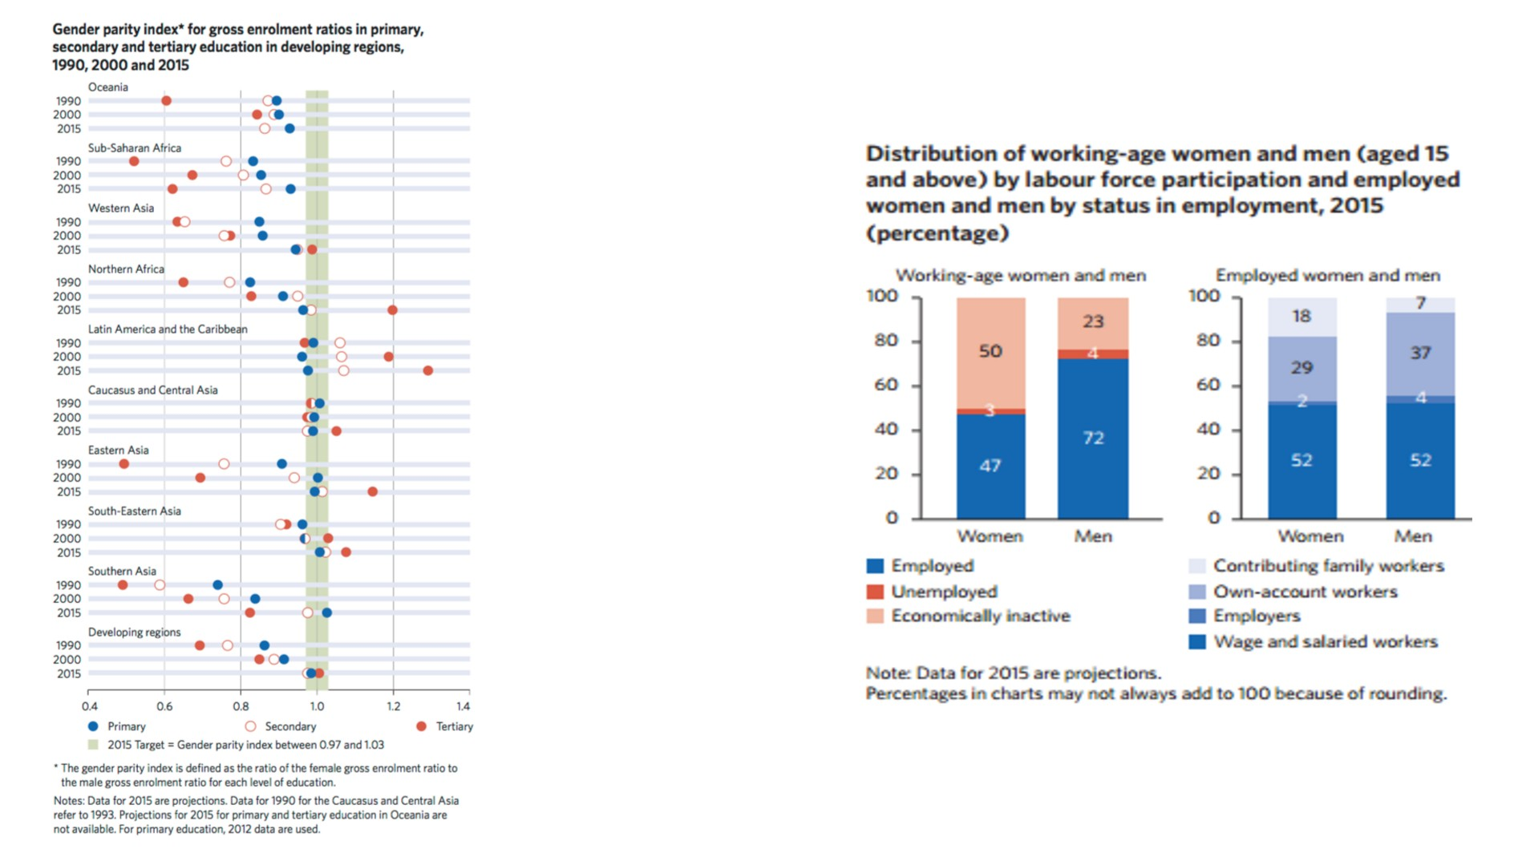

Slide 21
Child Mortality

Slide 22
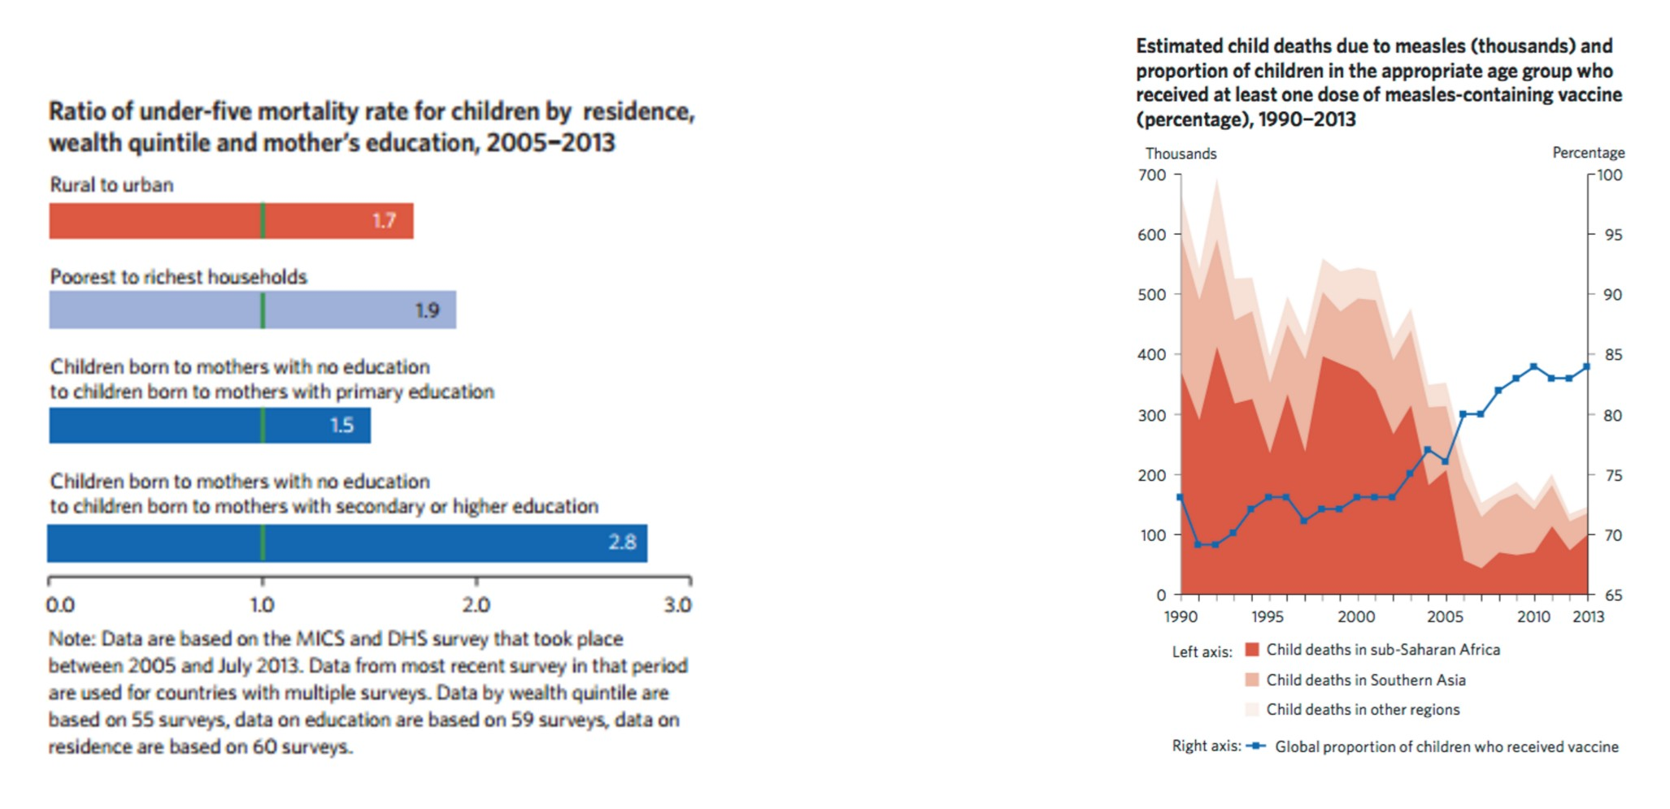

Slide 23
Maternal Mortality

Slide 24
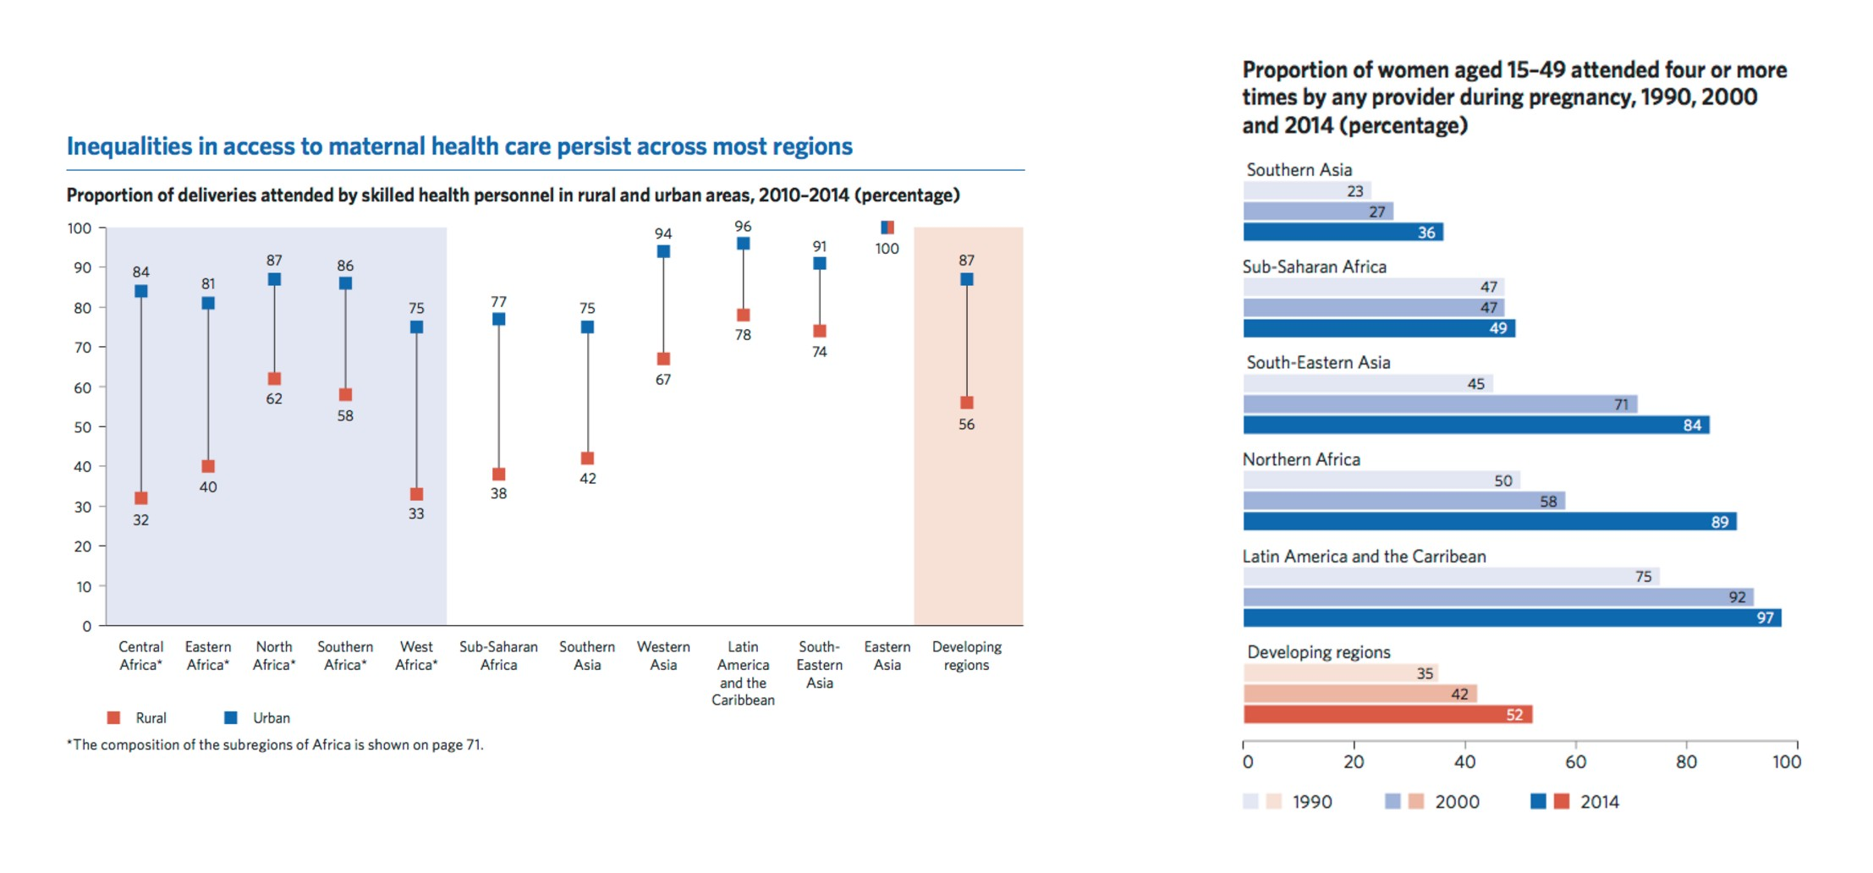

Slide 25
Combating Diseases

Slide 26
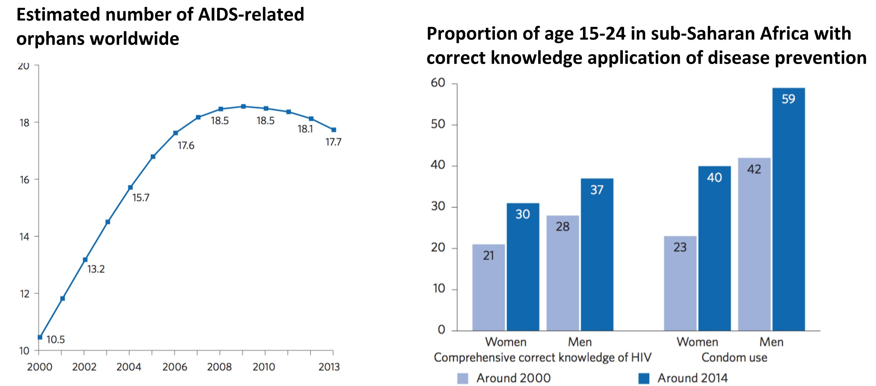
The number of people newly infected with HIV continues to decline

Slide 27
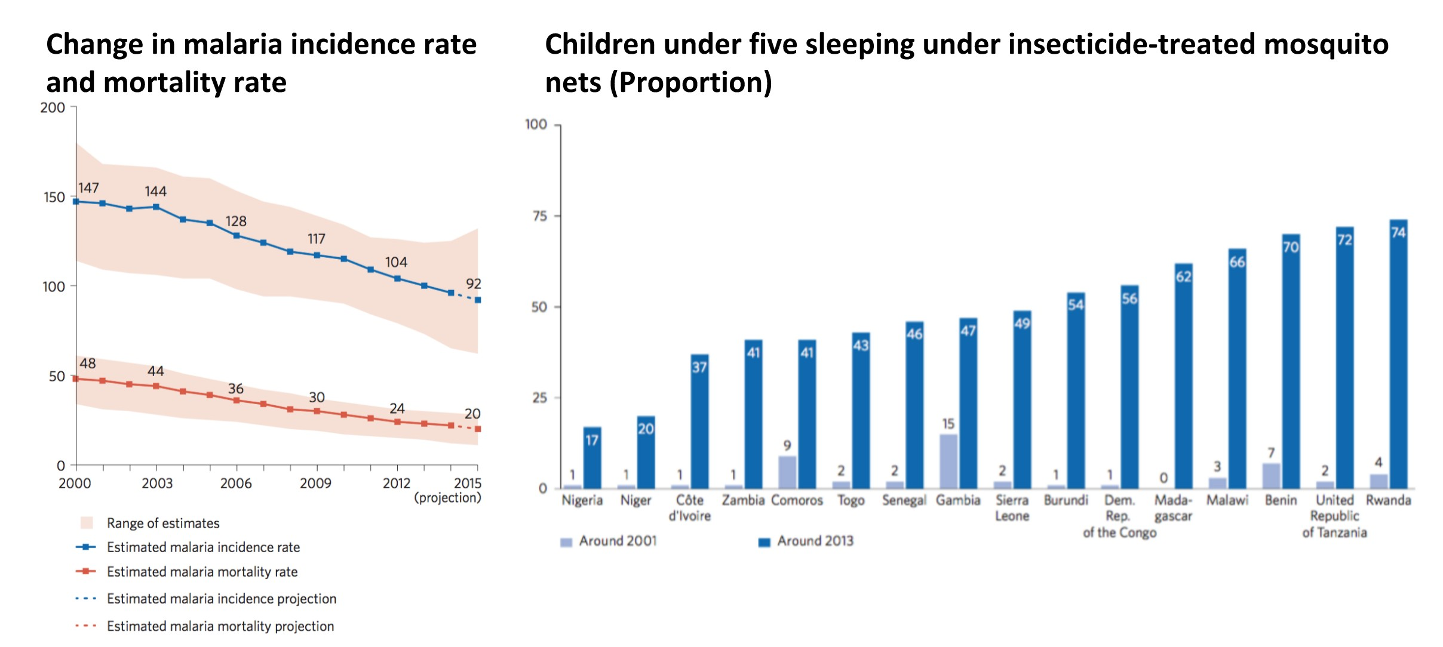

Slide 28
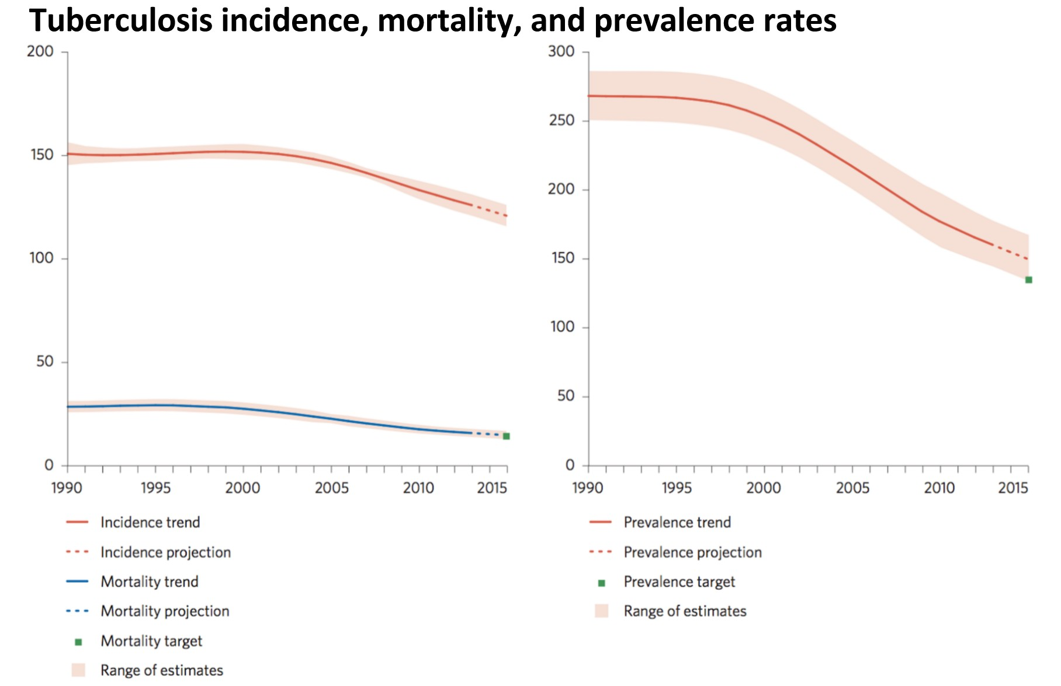

Slide 29
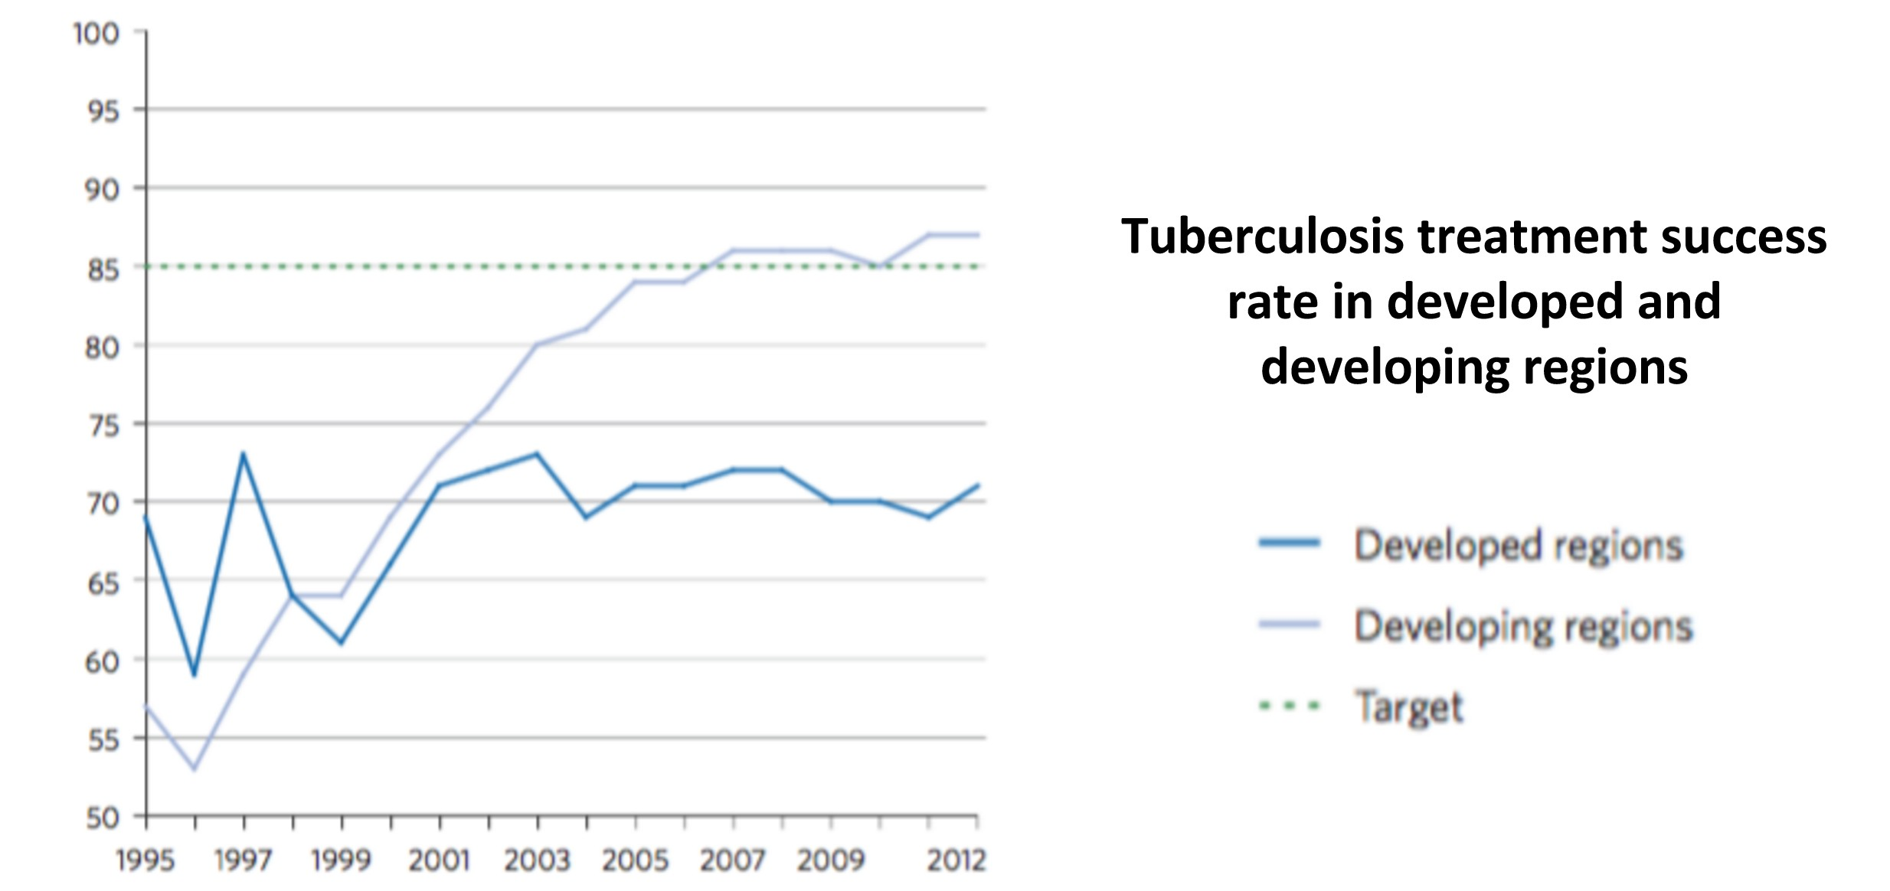

Slide 30
Environmental Sustainability

Slide 31
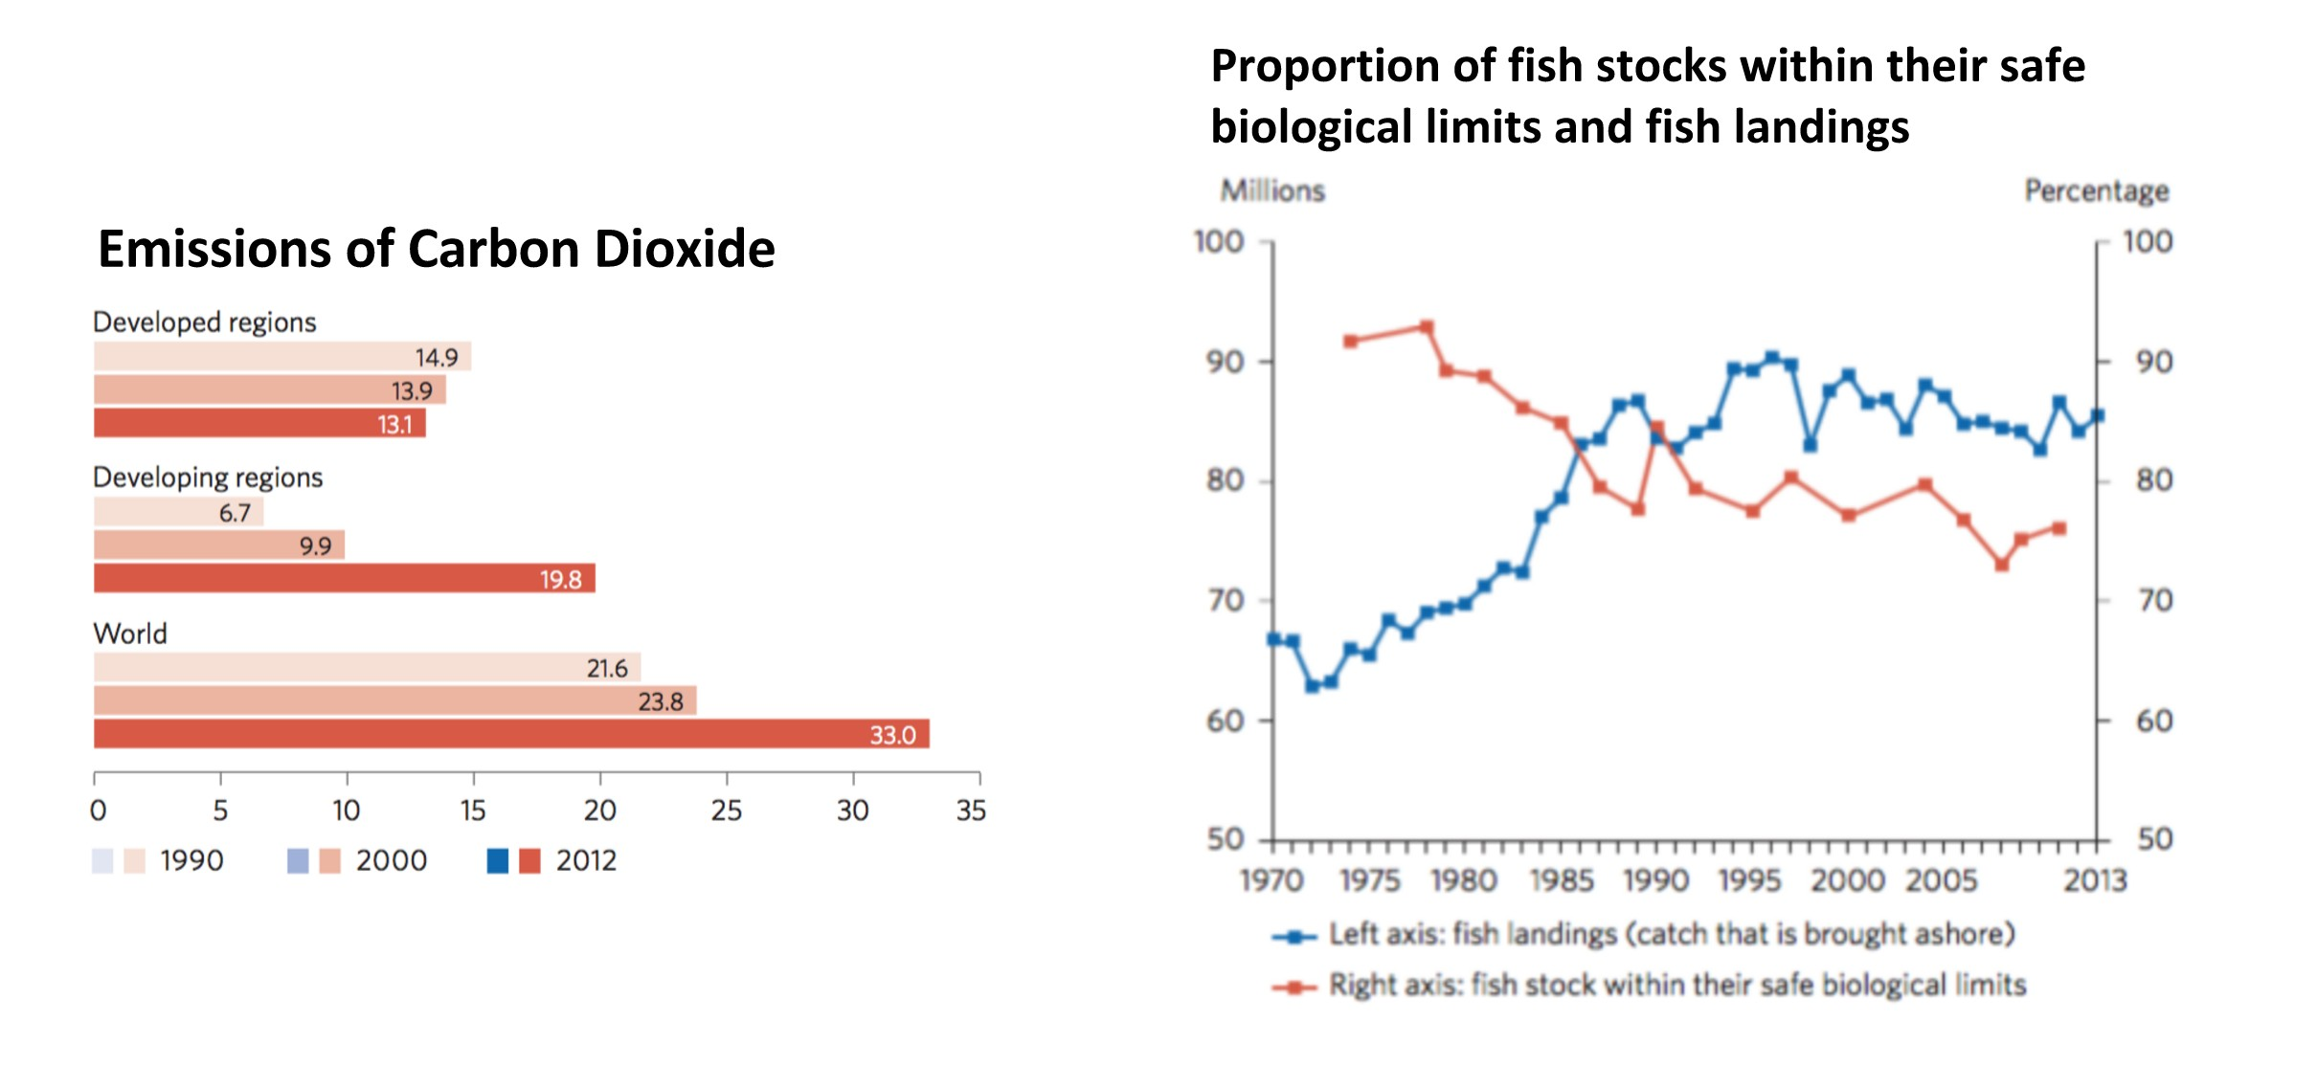

Slide 32
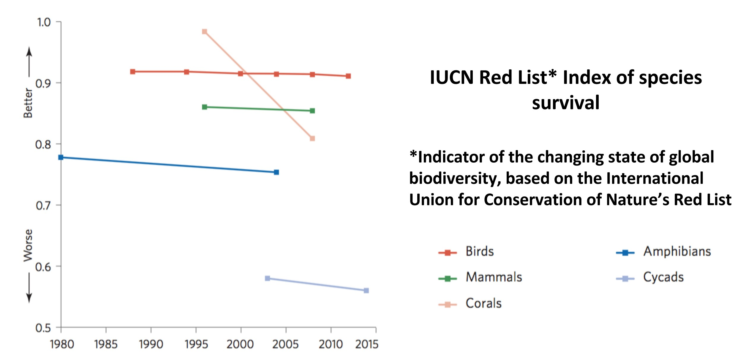

Slide 33
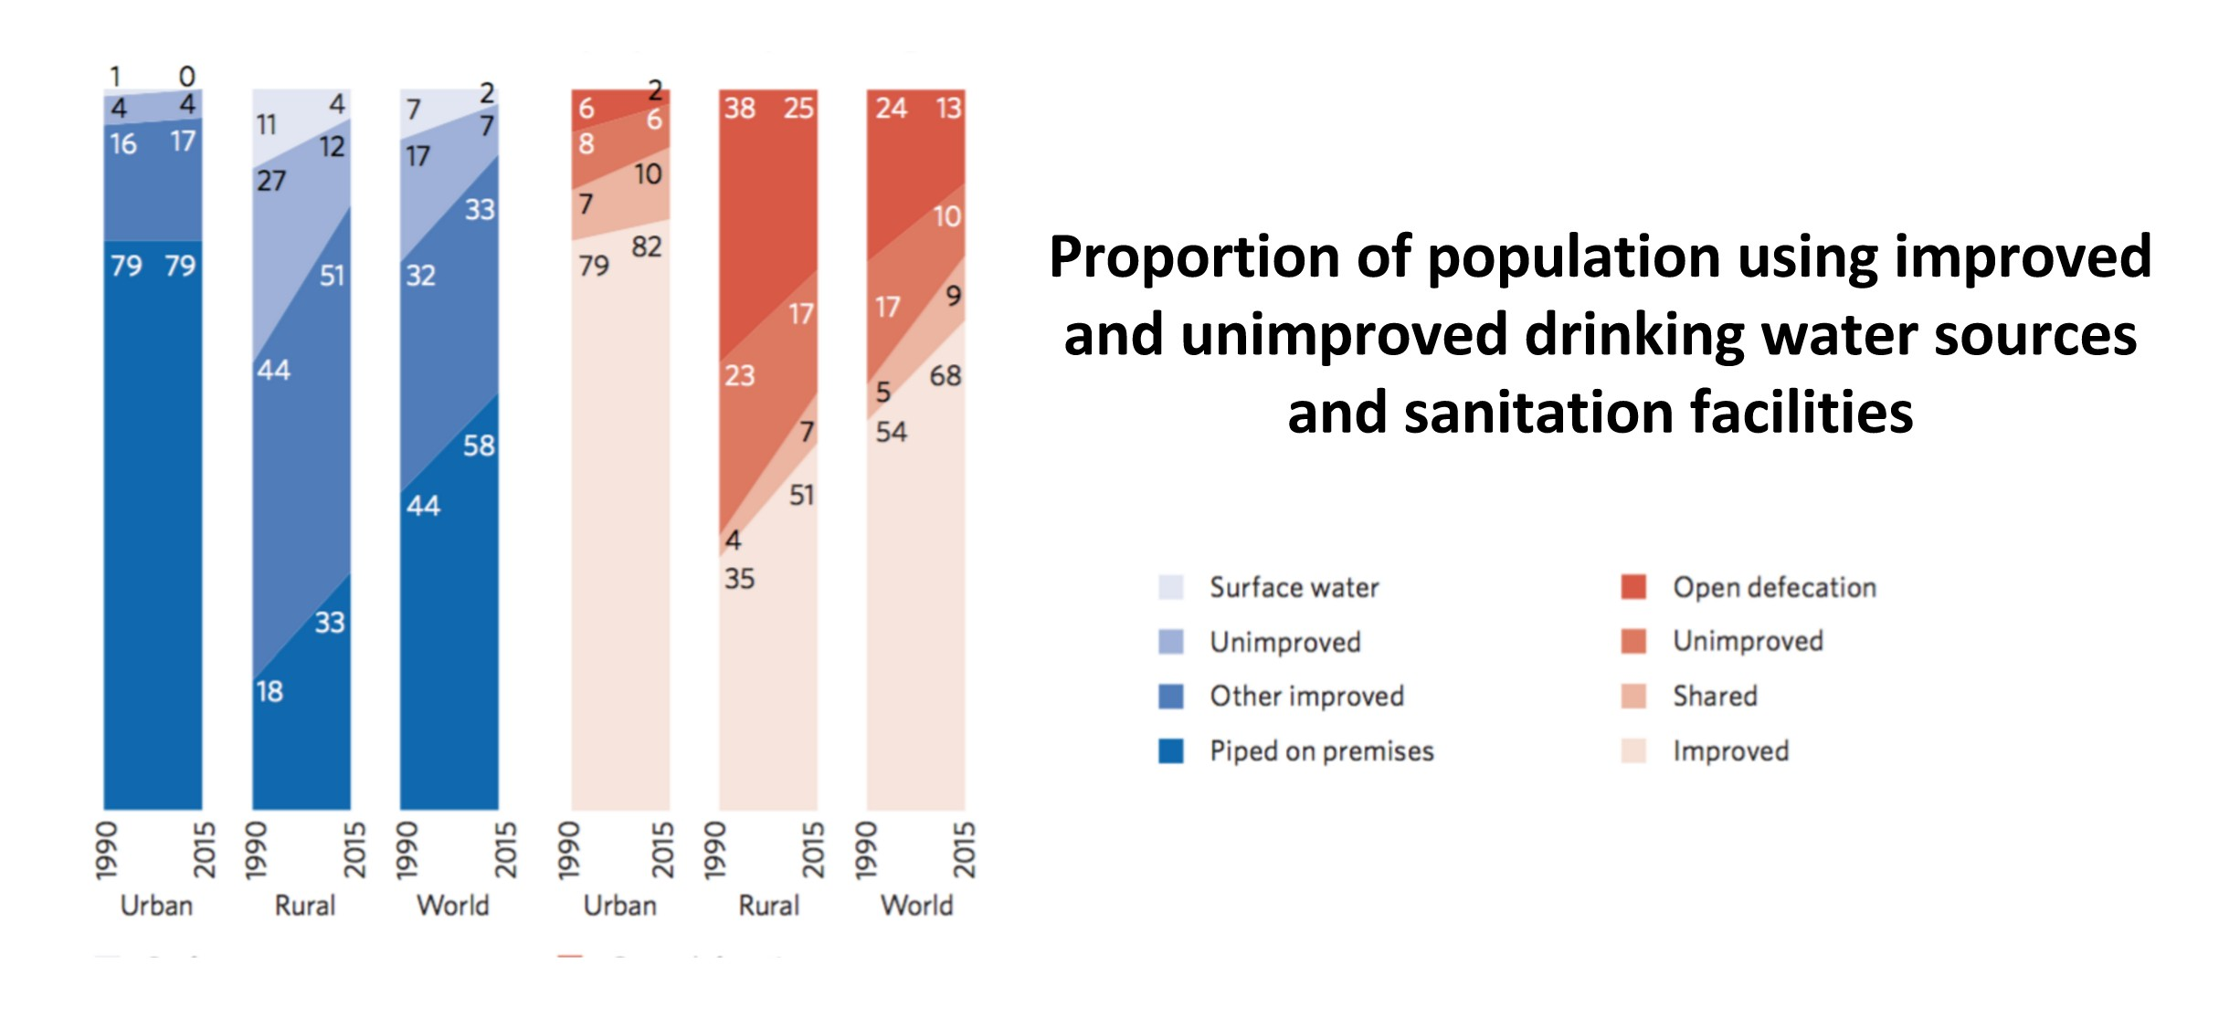

Slide 34
Setbacks due to crises, shocks, and vulnerabilities

Slide 35
Unexpected crises and unforeseen problems in certain regions have proven to be sudden and major obstacles that impede progress
2008 Economic Crisis severely affected many sub-Saharan African countries
Ebola outbreak teaches many lessons for health and development
Developing countries are vulnerable to natural disasters
Political instability and conflict has been a major factor hindering progress

Slide 36
Evidence-based Policymaking

Slide 37
EBP utilizes evidence from research to inform the policymaking process.

Slide 38
The current fiscal environment makes it imperative that we produce more value with each dollar that government spends. Doing so will require better use of evidence in policymaking.
- The Hamilton Project from The Brookings Institution
One obvious tool missing from the budget-cutters’ toolbox is evidence-based policymaking.
- The Heritage Foundation

Slide 39
Advantage of EBP: its methodical approach to policymaking The advantage of EBP could be shown in three aspects:
social beneit economic beneit iscal beneit

Slide 40
EBP can also be applied to countries in transition, with greater potential for improvement.
Issues with applying EBP to countries in transition: political instability,
conflict,
academic freedom, media freedom, and civil society

Slide 41
Data Visualizations for Evidence-based Policymaking

Slide 42
Data Visualization:
“the use of computer-supported interactive visual representations of abstract data to amplify cognition”
- Card, Mackinlay, Shneiderman (1999)

Slide 43
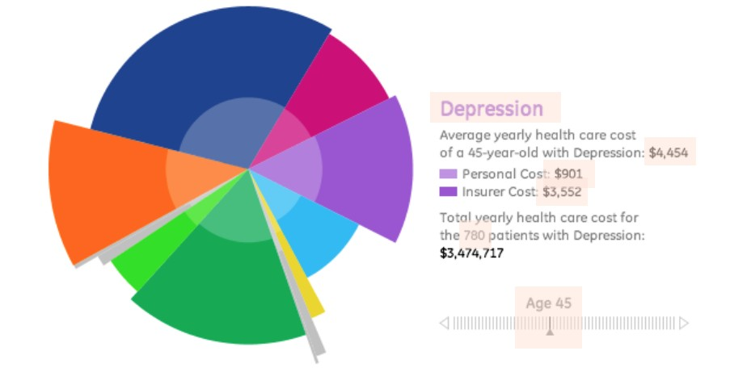
Figure: Visualization of medical costs, by Ben Fry of Seed Media Group, seen in “Information Visualization, Design, and the Arts: Collision or Collaboration” (Few, 2010)
Few’s critiques:
What do the radii mean?
Should we compare the areas of the slices? What about the angles of the slices?
Trouble comparing radii and areas

Slide 44
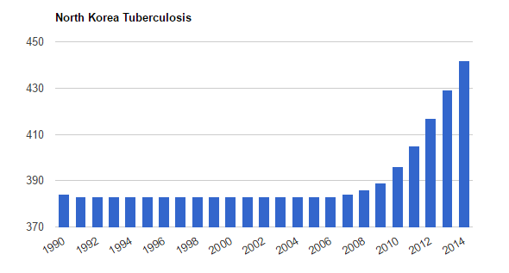
Figure: TB in the DPRK from “North Korea Tuberculosis”, TheGlobalEconomy.com
Quantitative values should be displayed using the lengths of simple, two-dimensional objects.

Slide 45
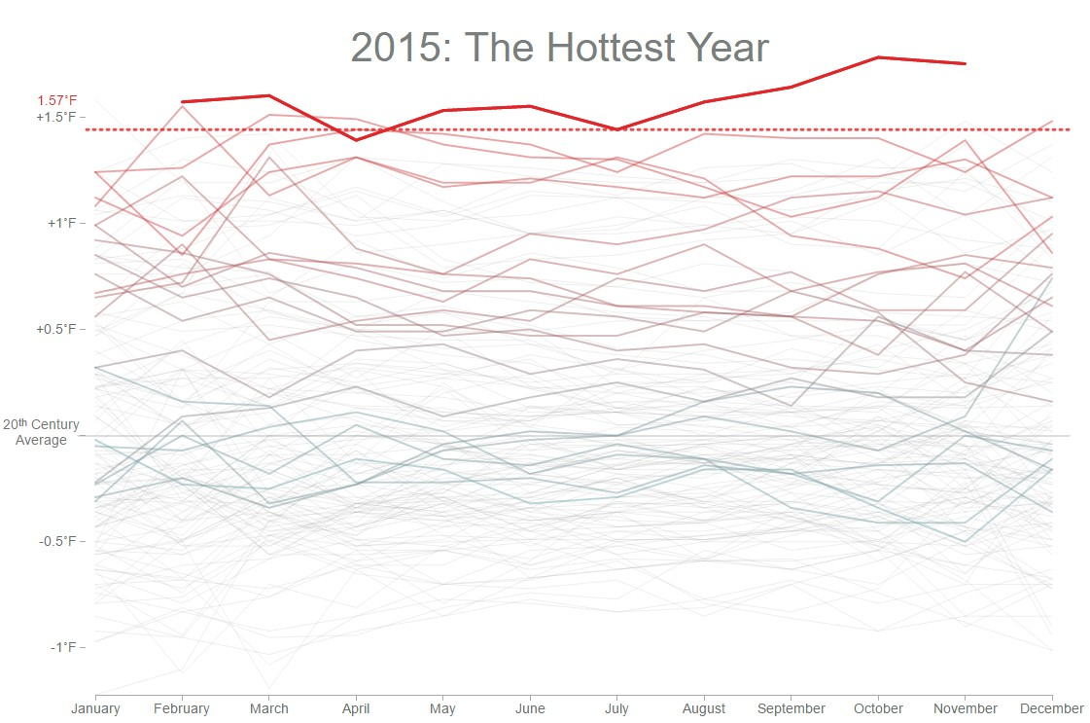
Figure: Snapshot of animation showing temperatures, 1880-2015, from bloomberg.com
Viewers cannot see a pattern formed by multiple values if they only look at one value at a time.

Slide 46
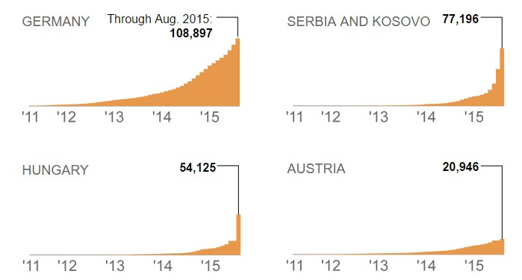
Figure: Asylum applications, April 2011 - August 2015, extracted from latimes.com
Showing multiple graphs together can be better than showing a single graph.

Slide 47
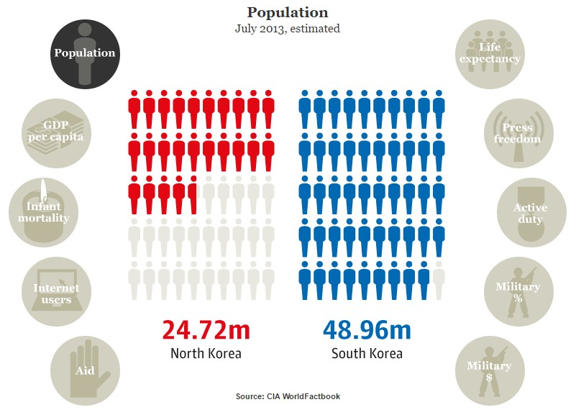
Figure: North Korea vs. South Korea, 2013, from theguardian.com
Viewers should be able to focus on data of interest.

Slide 48

What comes to mind when you glance at this picture?

Slide 49
503 x 26

Slide 50
System One
"Fast thinking" Intuitive
System Two
"Slow thinking" Effortful

Slide 51
Interactive DVs trigger System Two
Visualizations tailored to key policy issues for countries in transition
49
Data Visualization Designers:
Igor Barahona, Ariel Lee, Hannah Cho, Giang Nguyen, Star Ying

Slide 52
Poverty in Mexico and its Relation with Social Metrics
Igor Barahona

Slide 53
Women’s Health, Education and Political Empowerment in Developing and Developed Countries and Evidence-Based Policy Implications
Ariel Lee

Slide 54
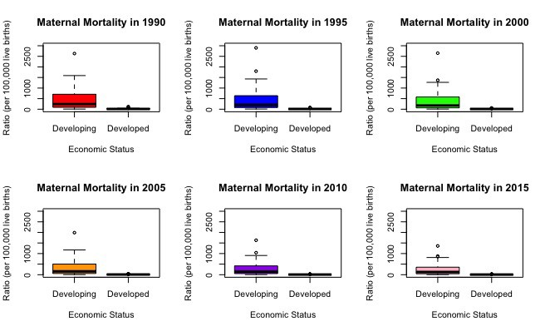
Maternal Mortality Ratio per 100,000 live births of Developing and Developed Countries

Slide 55
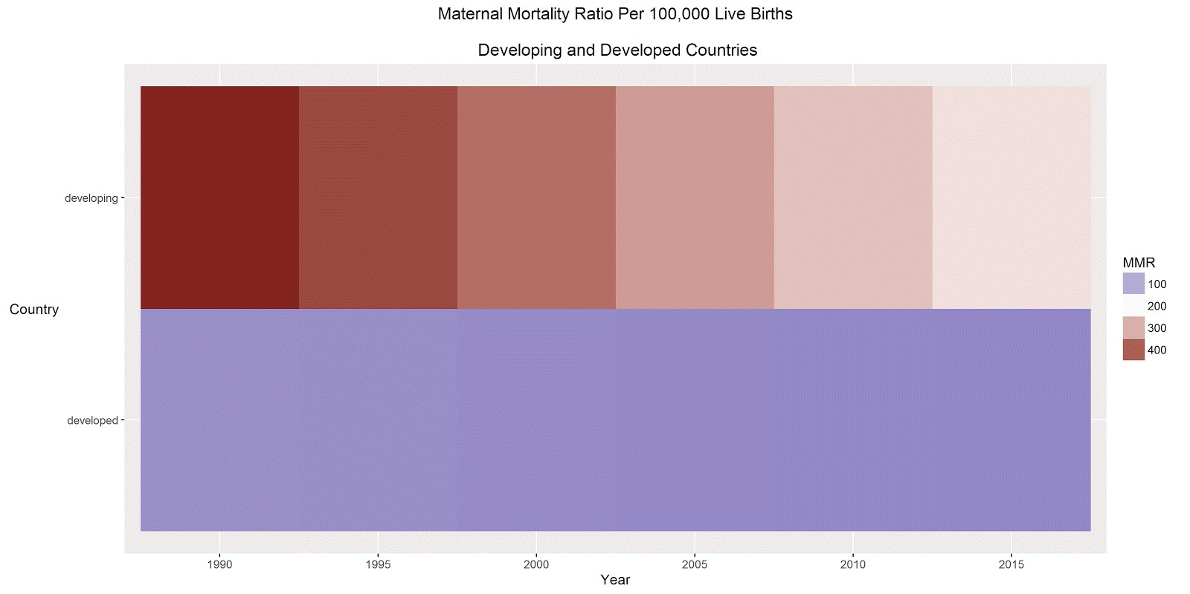
Heatmap of Maternal Mortality in Developing and Developed Countries
53

Slide 56
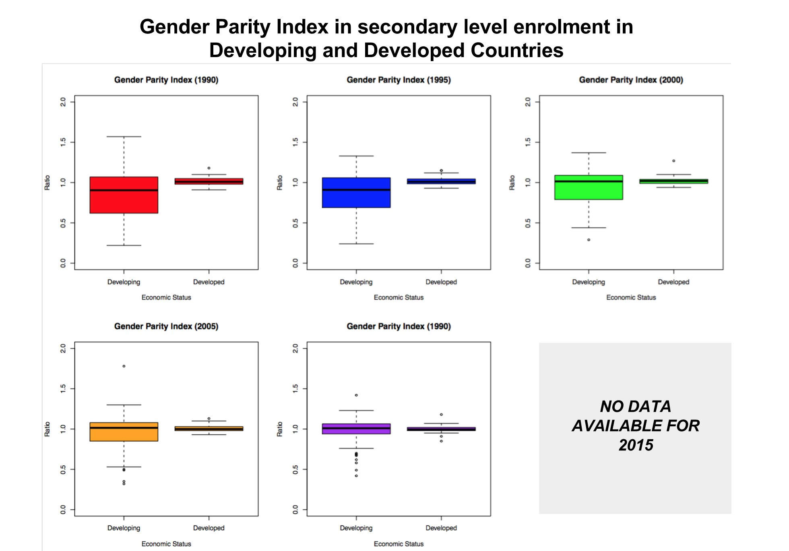
Gender Parity Index in secondary level enrolment in Developing and Developed Countries
54

Slide 57
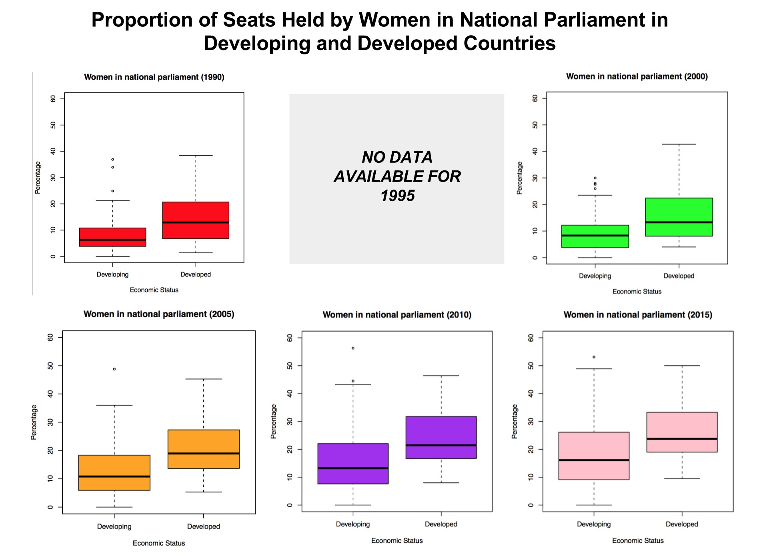
Proportion of Seats Held by Women in National Parliament in Developing and Developed Countries
55

Slide 58
Focus more on helping certain developing countries (outliers) Developing countries contain a range of countries
56
Developed countries need to work on women in higher levels of society

Slide 59
Malnutrition in Central America and its Relationship to Key Health Conditions
Hannah Cho

Slide 60
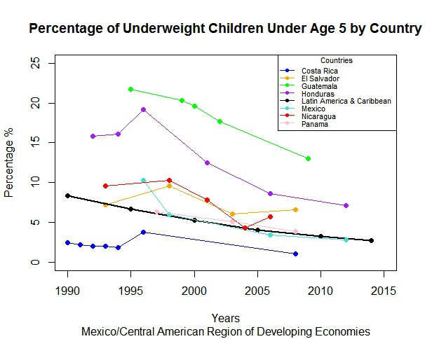

Slide 61
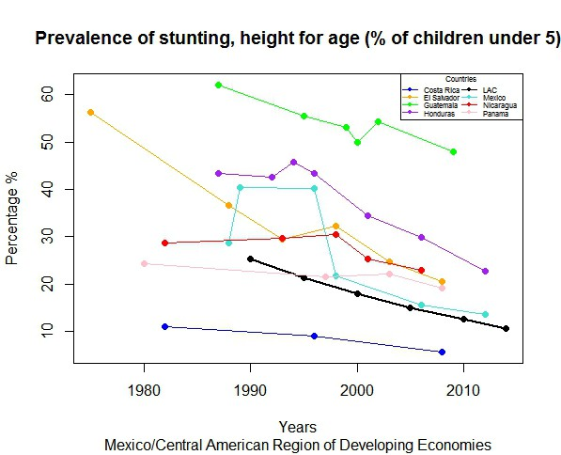

Slide 62
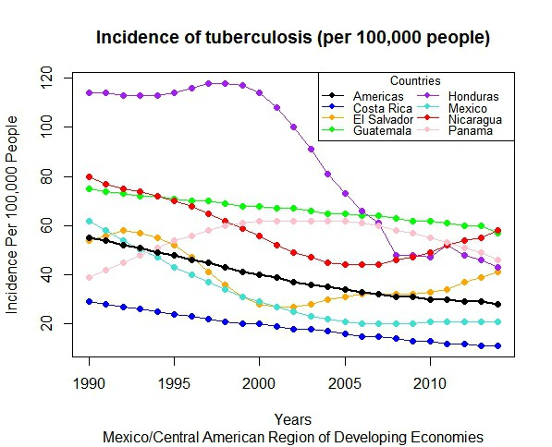

Slide 63
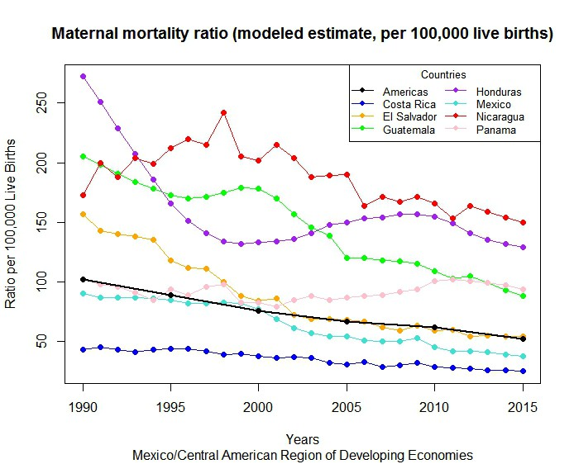

Slide 64
Use countries such as Costa Rica and Honduras as examples Inequalities in access to health care facilities need to be eliminated. Focus on countries like Nicaragua and Guatemala

Slide 65
Malnutrition in DPRK (North Korea) and Evidence-based Policy Implications
Giang Nguyen

Slide 66
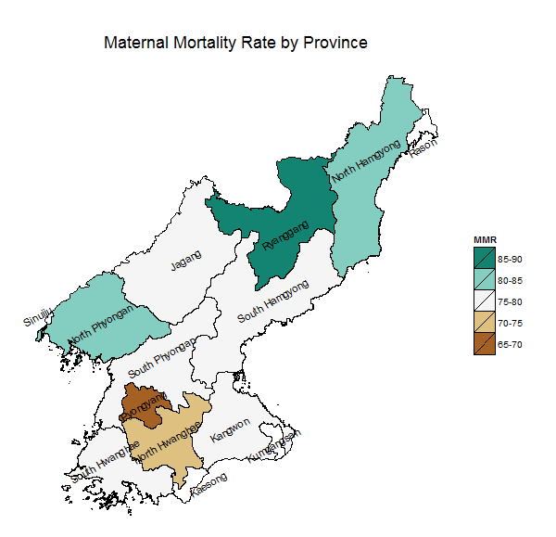

Slide 67
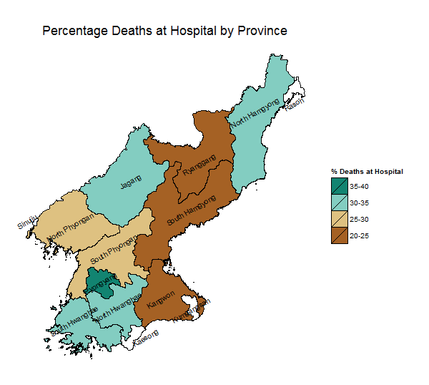

Slide 68
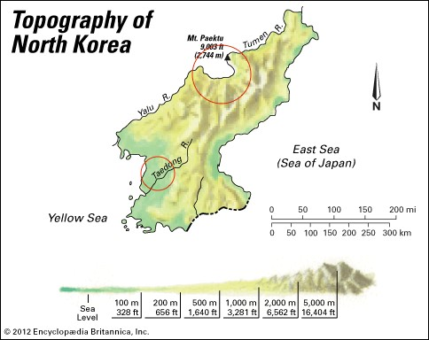

Slide 69
Chronic malnutrition (stunting)
Deined from the height of age (H/A) index, expressed in z-score (HAZ)
HAZ represents the number of standard deviations units from the median of the WHO 2006 reference population.
Global stunting is deined as HAZ < -2 SD.
Moderate stunting is deined as HAZ < -2 SD and >= -3 SD. Severe stunting is deined as HAZ < -3 SD.
Stunting is irreversible after 24 months of age.

Slide 70
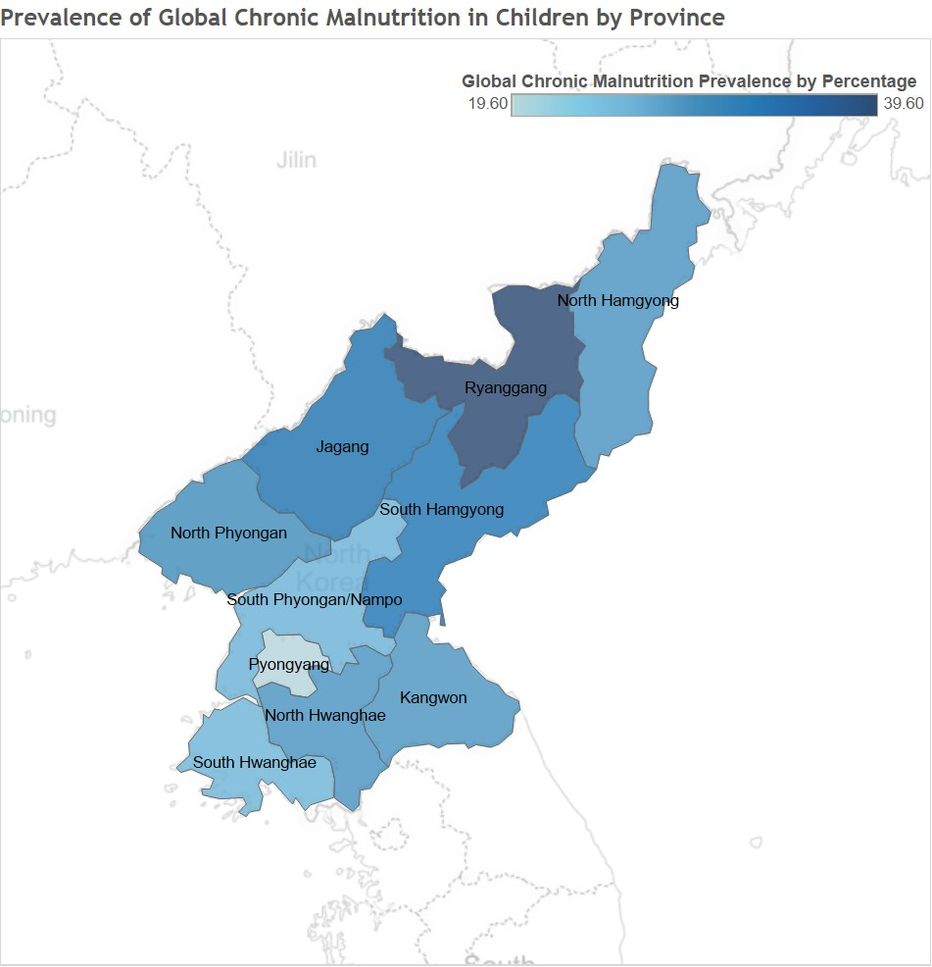

Slide 71
Acute malnutrition (wasting)
Estimated from the weight for height (W/H) index, expressed in z- score (WHZ)
WHZ represents the number of standard deviations units from the median of the WHO 2006 reference population.
Global wasting is deined as WHZ < -2 SD.
Moderate wasting is deined as WHZ < -2 SD and >= -3 SD. Severe wasting is deined as WHZ < -3 SD.

Slide 72
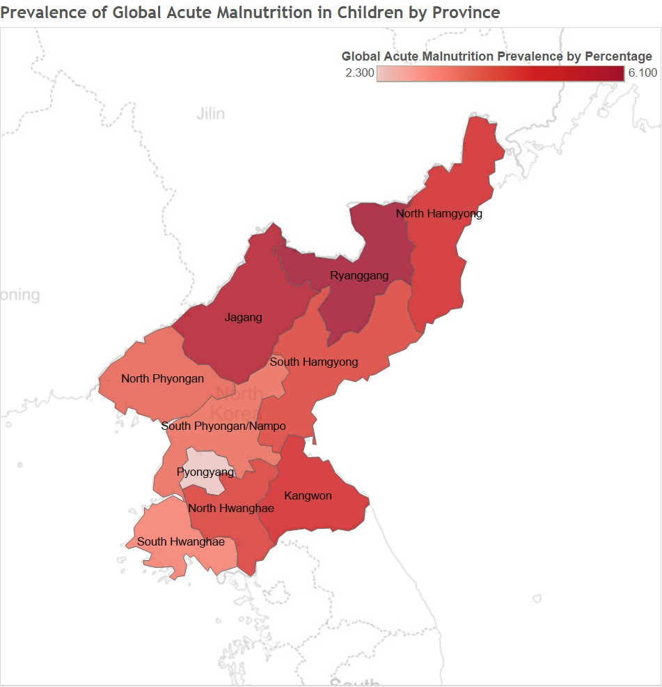

Slide 73
Interactive DVs of Public Health Issues
Giang Nguyen

Slide 74

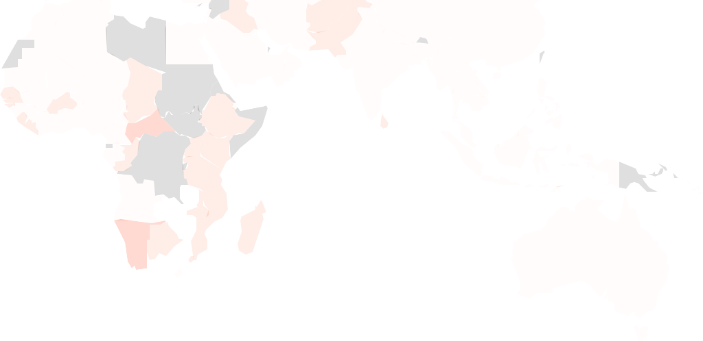
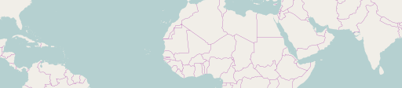
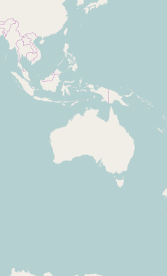

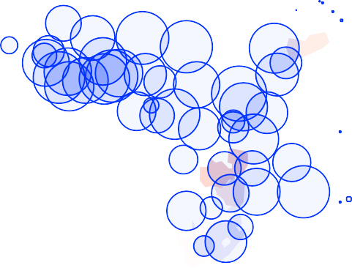
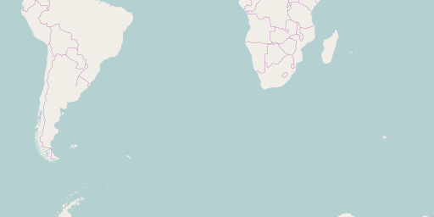

Choose a year:
1991
2015
Population undernourished (%)
0 – 20
20 – 40
40 – 60
60 – 80
80 – 100
NA
1991 1994 1997 2000 2003 2006 2009 2012 2015
Population not using improved sanitation facilities (%)
Leaﬂet (http://leaﬂetjs.com) | © OpenStreetMap (http://openstreetmap.org) contributors, CC-BY-SA (http://creativecommons.org/licenses/by-sa/2.0/)
Data source: United Nations' MDG Indicators Database (http://mdgs.un.org/unsd/mdg/Data.aspx). Please send questions and comments to Giang Nguyen (giang.huong.nguyen92@gmail.com)
https:/ star-is-here.shinyapps.io/giang_leaflet/

Slide 75
Visualizing Malnutrition in DPRK
Star Ying

Slide 76
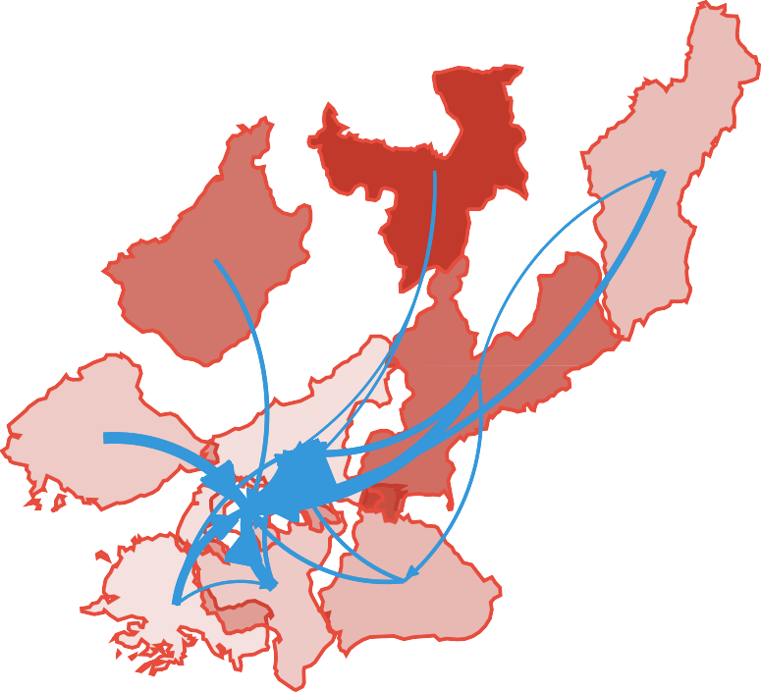
Province: Stunting Rate(%)
Net Migration Exceeding 1000

Slide 77
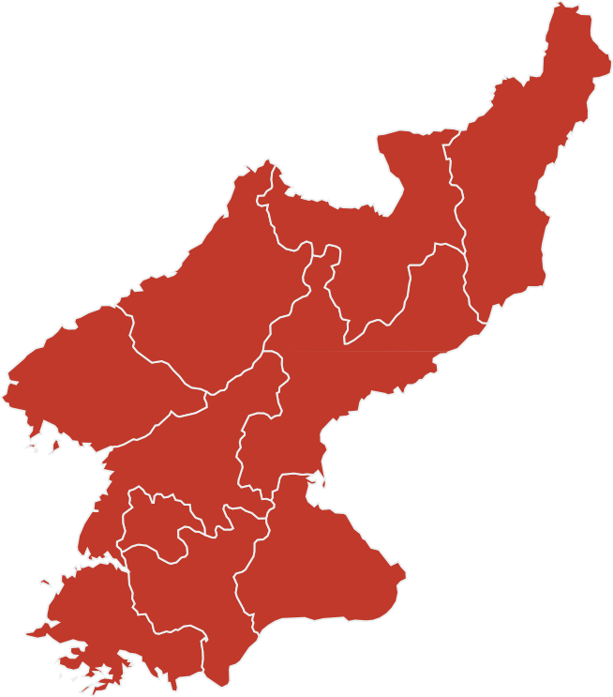
Province (Population): Global Chronic Malnutrition Global Acute Malnutrition

Slide 78
Visualizing Extensions to Social and Educational Indicators
Star Ying

Slide 79
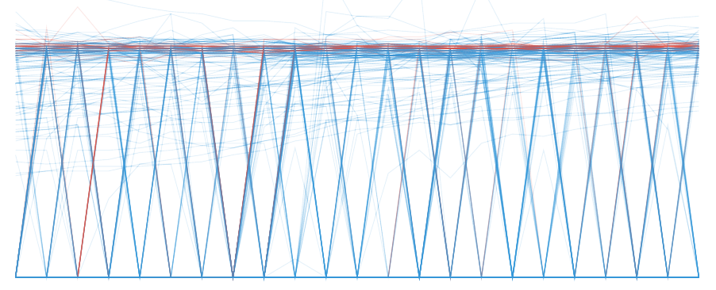
Gender Parity Index in primary level enrolment
1990
1991
1992
1993
1994
1995
1996
1997
1998
1999
2000
2001
2002
2003
2004
2005
2006
2007
2008
2009
2010
2011
2012
1.0
0.8
0.6
0.4
0.2
0.0

Slide 80
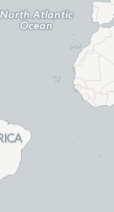
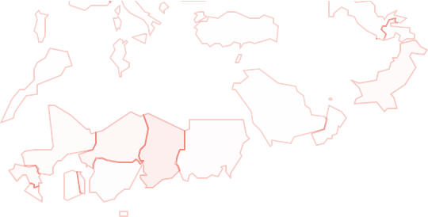
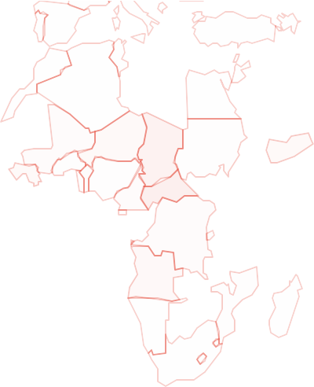
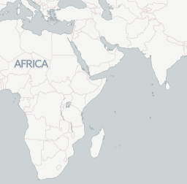

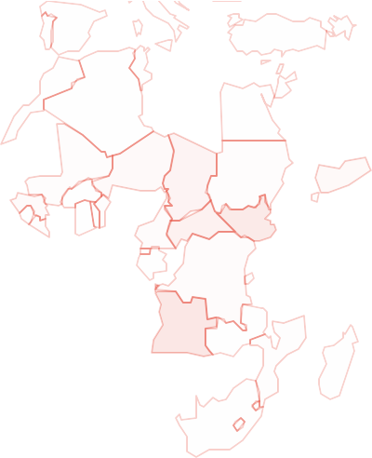
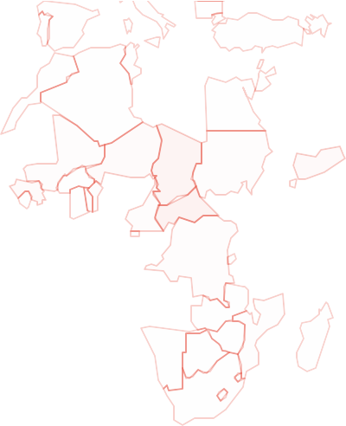
Gender Parity Index in primary level enrolment (2009-2012)
+
-
Hover over a nation
for Gender Parity Index
2009
2010
2012
2011
Leaﬂet

Slide 81
We can use data visualizations of existing indicators to determine where nations are falling behind
Supplement existing indicators with data from instruments that allow us to identify intervention points
Can we use alternative data sources? administrative records,
cellphone usage, or satellite data.

Slide 82
Using Satellite imagery as proxies for MDG Indicators
Two Satellite Products
Visible Infrared Imaging Radiometer Suite (VIIRS) Nighttime Lights Defense Meteorological Satellite Program (DMSP) Nighttime Lights

Slide 83


North Korea vs South Korea

Slide 84

Monthly Average Radiance Levels of various Asian Nations from 2014 to present
2.6
2.4
2.2
2
1.8
1.6
1.4
1.2
1
0.8
0.6
0.4
0.2
0
Jan 2014
Apr 2014
Jul 2014
Oct 2014
Jan 2015
Apr 2015
Jul 2015
Oct 2015
Jan 2016
china
north-korea
south-korea
bangladesh
vietnam
india
japan
republic-of-china
thailand

Slide 85

Monthly Average Radiance Levels of North Korean Provinces from 2014 to present (tenths of radiance)
83
8
7
6
5
4
3
2
1
0
Jan 2014
Apr 2014
Jul 2014
Oct 2014
Jan 2015
Apr 2015
Jul 2015
Oct 2015
Jan 2016
North Hamgyong
Pyongannam-do
North Pyongan
Hwanghaenam-do
Pyongyang
Ryanggang
Kangwon-do Chagang
Kaesong Industrial Region Hwanghaebuk-do gun_Kumgangsan Tourist Region
Hamgyongnam-do
Kumgang-

Slide 86

Monthly Average Radiance Levels of the Korean Peninsula Provinces from 2014 to present
84
50
45
40
35
30
25
20
15
10
5
0
Jan 2014
Apr 2014
Jul 2014
Oct 2014
Jan 2015
Apr 2015
Jul 2015
Oct 2015
Jan 2016
North Hamgyong Hwanghaebuk-do
Pyongannam-do Hamgyongnam-do
North Pyongan
Hwanghaenam-do
Pyongyang
Ryanggang
Kangwon-do
Chagang
Kaesong Industrial Region u'Seoul' u'Gyeongsangbuk-
do' u'Gwangju' u'Daejeon'
u'Chungcheongbuk-do'
Kumgang-gun_Kumgangsan Tourist Region
"[u'Chungcheongnam-do' u'Gangwon-do'
u'Jeju-do'
u'Busan'
u'Gyeonggi-do' u'Jeollanam-do'
u'Sejong'
u'Daegu'
u'Ulsan'
u'Gyeongsangnam-do'
u'Incheon' u'Jeollabuk-do']"

Slide 87
85
SORT BY SERIES / CORRELATION COEFFICENT
SERIES: CORRELATION COEFFICIENT
Download Dataset

Slide 88
Visualizations/dashboarding is useful for policy but it is limited by the strength of the underlying data used
There is potential to extend existing indicators with alternative data sources
Further study is required

Slide 89
Conclusions

Slide 90
Merits and drawbacks of data visualization for evidence-based policy development
Missing data
Correlation is not causation
Beneits of interactive data visualization Next steps:
Create cohesive dashboard for all countries in transition

Slide 91
2015: the year in graphics. (n.d.). Retrieved July 27, 2016.
A good news case study: Tanzania Essential Health Interventions Project. (n.d.). Retrieved July 27, 2016.
Acosta, M., Bermudez, J. L., Saenz, M.R. (2010). Universal Coverage in a Middle Income Country: Costa Rica. WHO.
Buitron, R., Paepe, P. D., Soors, W., Unger, J. P. (2008 April). Costa Rica: Achievements of a Heterodox Health Policy. Am J Public Health.
Card, S. K., Mackinlay, J. D., & Shneiderman, B. (1999). Readings in Information Visualization: Using Vision to Think. Morgan Kaufmann.
Central Bureau of Statistics. (2009). DPR Korea 2008 Population Census National Report. Pyongyang.
Central Bureau of Statistics. (2013). Democratic People’s Republic of Korea Final Report of the National Nutrition Survey 2012. Pyongyang.
Dale, S. (2011, January 13). CASE STUDY: Crunching the numbers. Retrieved July 27, 2016. Elbow, G. S. (2016) Costa Rica. In Encyclopædia Britannica.
Few, S. (2010). Information Visualization, Design, and the Arts Collision or Collaboration. Visual Business Intelligence Newsletter, 1–11.
Few, S. (2011, December). Beneitting InfoVis with Visual Dificulties? Provocation Without a Cause. Visual Business Intelligence Newsletter Perceptual Edge.

Slide 92
Foundation for Sustainable Development. (n.d.). Child and Maternal Health Issues in Nicaragua.
Haskins, R., & Baron, J. (2011). Building the connection between policy and evidence. The Obama evidence-based initiatives. NESTA.
It’s Oficial: 2014 Was the Hottest Year on Record. (n.d.). Retrieved July 27, 2016. Kahneman, D. (2011). Thinking, Fast and Slow. Macmillan.
Korea, North: topography. (n.d.). Retrieved July 27, 2016.
Krishnakumar, P., & Lauder, T. S. (n.d.). Where are Syria’s refugees now? Retrieved July 27, 2016.
Liebman, J. B. (2013). Building on recent advances in evidence-based policymaking. Washington, DC: Brookings Institution.
Millennium Development Goals Indicator. (n.d.). Retrieved July 27, 2016.
Muhlhausen, D. B. (2015). Evidence-based policymaking: A primer. The Heritage Foundation.
Neilson, S., & Smutylo, T. (2004). The TEHIP “Spark”: Planning and managing health resources at the district level. IDRC - International Development Research Centre.
Nguyen, G., Ying, S., Chun, E., Lim, E., Cho, H., Tae, C., … Chun, A. Y. (2015). Data Visualization to Aid Humanitarian Intervention Strategies. ESRA.
Open Data Catalog. (n.d.). Retrieved July 27, 2016.

Slide 93
Pineda, C.R.A., Figuero, E. B., Reneau-Vernon, L., Paredes, C., Guemes, A.,... Seaman, I. (February 2009). Health Systems Proile Honduras: Monitoring and Analyzing Health Systems Change/Reform. Pan American Health Organization.
Saenz, M.R., Bermudez, J. L., Acosta, M. (2010). Universal Coverage in a Middle Income Country: Costa Rica. WHO.
Sutcliffe, S., & Court, J. (2005). Evidence-Based Policymaking: What is it? How does it work? What relevance for developing countries. Overseas Development Institute.
TheGlobalEconomy.com. (n.d.). North Korea Tuberculosis. Retrieved June 21, 2015. The Guardian. (n.d.). North Korea v South Korea in Figures - Interactive [The Guardian].
Unger, J. P., Paepe, P. D., Buitron, R., Soors, W. (2008 April). Costa Rica: Achievements of a Heterodox Health Policy. Am J Public Health.
WHO. (May 2014). Country Cooperation Strategy at a Glance: Guatemala.
World Health Organization (2016). Global Database on Child Growth and Malnutrition.

